Slide 1

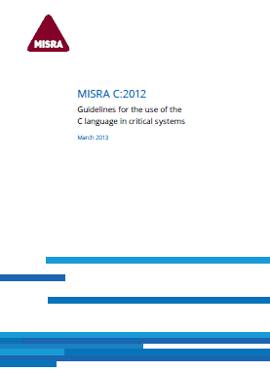
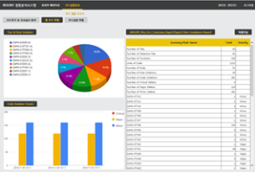



RESORT Static Analysis Toolset
Tool Name
RESORT for C, C++, C# Java(JSP), R Python, JavaScript, Flex, ABAP
RESORT for Mobile(iOS, Android)
RESORT for JavaFP
Using RESORT Toolset
IDE & CI-Server Plug-in
Eclipse, Intellij, Android Studio, Visual Studio, Xcode, etc.
Jenkins/Hudson
Based on the uncompiled source code only, RESORT static analysis tool is an integrated static analysis that simultaneously checks Reliability(Coding Standard), Safety(Run-time Error) and Security(Security Vulnerability), and code metrics based on inter-procedural path analysis.
RESORT Product Features
(No Compile Step) Works on source code only using “RESORT Code Analysis” technology without building (compile) step
(No False Positive) Inter-procedural Path Analysis
(Fully Code Assurance Coverage) All detection of Reliability, Safety, Security
- Supporting One Guide to One Rule for readability
(Tool Qualification) ISO26262, IEC61508, EN50128, CWE Compatibility
Project(Source Code)
Reliability (Coding Standard)
Build
X
(Automobile) MISRA-C:2012/2004, MISRA-C++:2008
(Aerospace) JSF++, JPL Java/C, BSSC Java/C
Java, JS, Python, Flex, ABAP, (Mobile) Objective-C, Android
Code Analysis
Safety (Run-time Error)
Code Verification
CWE-658(for C), CWE-659(for C++), CWE-660(for Java), Others
Security (Security Vulnerability)
Defect Detection
CWE/OWASP(C, C++, C#, Java, JS, Python, R, Objective-C, Android), CERT
Code & Quality Metrics
Defect Report
MISRA Software Metrics, HIS Source Code Metrics
ISO 9126 Maintainability Quality Metrics
Function Point
Java Function Point Counting based on IFPUG
Web Dashboard
Code Defect Analysis & Statistics: Assessment of Rule Compliance, etc.
Code Defect Exception Transaction: Request & Acknowledgment
Embedded
Coding Standard
(MISRA etc.)
Run-time
Error
(CWE-658, etc.)
Security
Vulnerability
(CWE List)
Code Defect
Repository
RESORT for C, C++, Java Static Analysis Tool
RESORT Dashboard
Reliability
Safety
Security
Code Defect
Analysis
We are looking for software sales and business partners.
www.soft4soft.com
Soft4Soft Co., Ltd
+82-2-553-9464 E-mail: info{sale}@soft4soft.com

